Slide 1
Arnobius Book 3 “Pagan Gods are really Anthropomorphic”
Brienna DiPietro and Randall Childree

Slide 2
Arnobius: A Christian Convert
Sicca in Modern Tunisia
255 – 330 AD
Response to Diocletian
Proving his piety

Slide 3
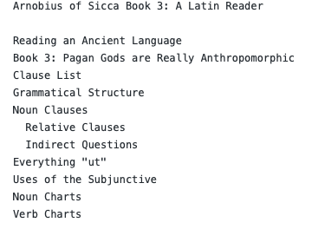
My Work
Read
Vocabulary Usage/Forms
Grammatical Analysis
Write actual comments
Establish Chunks
Describe Arguments
Notes:
Problem solving/critical thinking

Slide 4
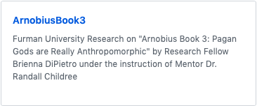

Outcomes
GitHub: BrieDiPietro/ArnobiusBook3
A published commentary
Dickinson’s College Commentaries
Used on campus
Notes:
Digital Tech with Git
Written commentary, communication
Teamwork in the department

